Slide 1
Tutorial 2
By Jeremy Lim

Slide 2
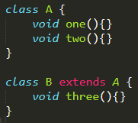
Last Week: How Polymorphism Works
A’s Methods
one
two
A’s Impl.
one
two
B’s Methods
one
two
three
B’s Impl.
three

Slide 3
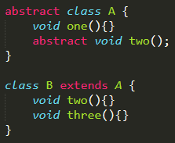
How Abstract Classes Work
A has two() but no implementation
A’s Methods
one
two
A’s Impl.
one
B’s Methods
one
two
three
B’s Impl.
two
three
Subclasses need to implement two()

Slide 4
How Abstract Classes Work
A has two() but no implementation
A’s Methods
one
two
A’s Impl.
one
B’s Methods
one
two
three
B’s Impl.
two
three
Subclasses need to implement two()

Slide 5


How Abstract Classes Work
A’s Methods
one
two
A’s Impl.
one
This is NOT okay
No instances of abstract classes
B’s Methods
one
two
three
B’s Impl.
two
three
Why? two() is defined but no implementation
(Intuitively) This should be a valid call, but no implementation = not okay
(Actually) Abstract classes do not need to have abstract methods, just that you can’t initialise an instance of one

Slide 6
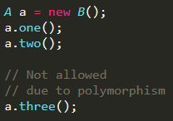
How Abstract Classes Work
A’s Methods
one
two
A’s Impl.
one
This is okay
Abstract classes can be the type of a variable
B’s Methods
one
two
three
B’s Impl.
two
three

Slide 7
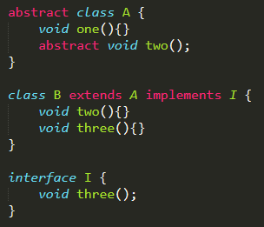

How interfaces work in one slide
A’s Methods
one
two
A’s Impl.
one
B’s Methods
one
two
three
B’s Impl.
two
three
I’s Methods
three

Slide 8
Don’t get it?
A’s Methods
one
two
A’s Impl.
one
B’s Methods
one
two
three
B’s Impl.
two
three
Interfaces have no implementation (In general)
Interfaces can be used as a type of a variable i.e. If you understand polymorphism fully (which you hopefully do), defines what methods the variable has
I’s Methods
three

Slide 9
More words on interfaces
Interfaces guarantee that a class has implemented a set of methods
So you are able to use the methods without caring how it is implemented or what else the class does
E.g. a Phone implements a Clock that you can getTime().
With proper naming of methods, getTime() gets the time regardless of how the time is stored and how the time is retrieved, or what else the phone does (it is irrelevant)
E.g. Sending letters to someone else and you don’t care when or how it reaches them
When you sendLetter(), you don’t care if it is sent via Email, SnailMail, MorseCode, etc.

Slide 10
How to write readable & manageable code

Slide 11
Foreword
Code quality isn’t as important this semester as previous semesters (when I made these slides)
I’m not conducting labs this semester so I don’t need to stare at bad code ☺
But your lab TAs will appreciate it if you take the time to make your code understandable
You will understand your own code better as well when you need to debug

Slide 12
End goal
Code that is easy to understand (Readable)
i.e. mostly self-explanatory
Code that is easy to add on to (Manageable)

Slide 13
Level 1: Commenting, Naming, and Formatting

Slide 14
Context
Terrible code generously crafted and donated by a friend.

Slide 15
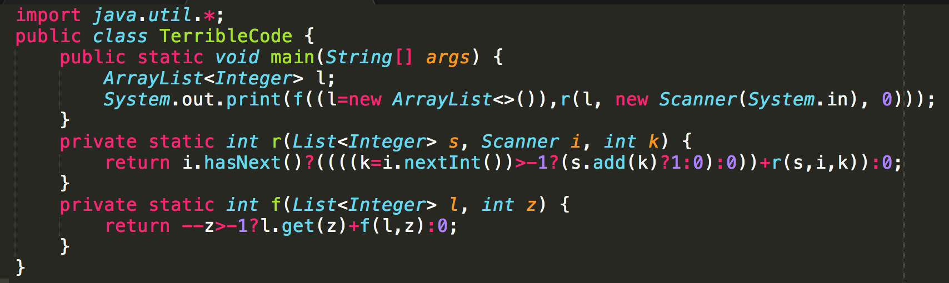
Mystery Code
You have 10 seconds.

Slide 16
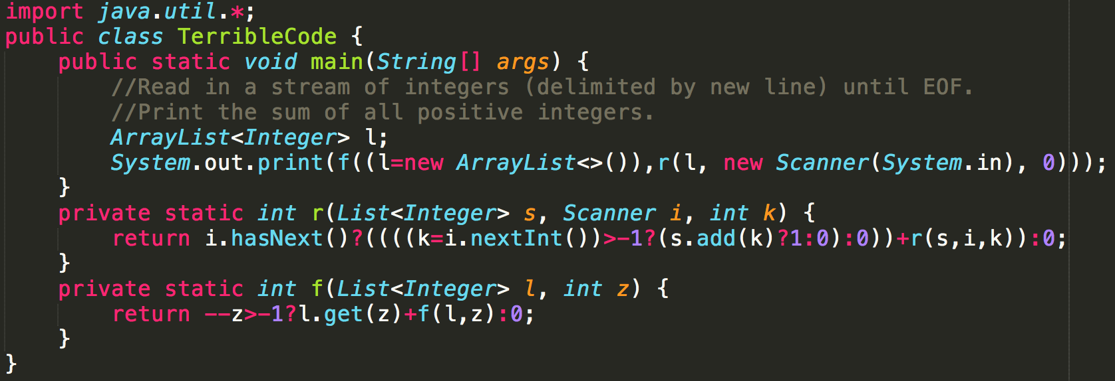
Mystery Code
Better?
No.
Work done: Commented code
Notes:
Comments

Slide 17
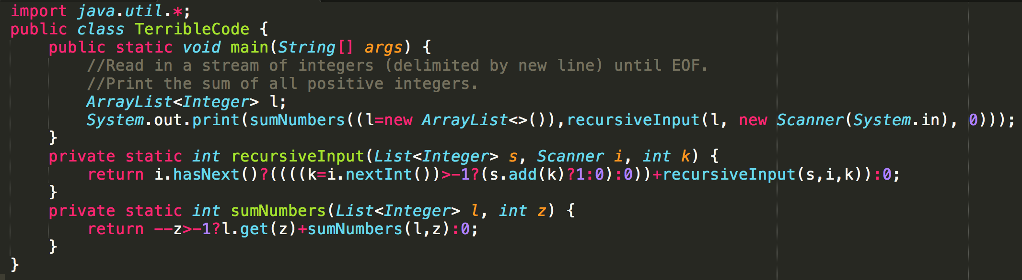
Mystery Code
Better?
A bit.
Work done: Renamed methods
Notes:
Naming methods

Slide 18
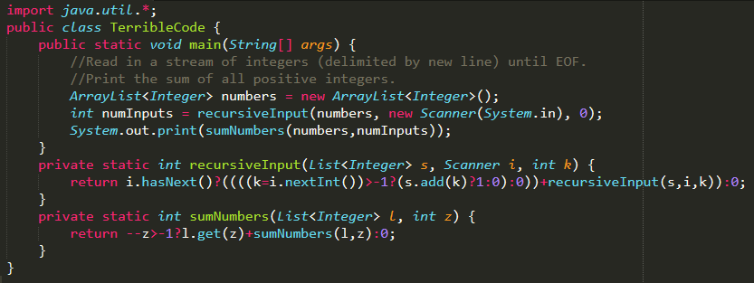
Mystery Code
Better?
Yes. I understand main() now.
Work done: Split a single line into multiple lines of code
Notes:
Split complicated 1-liners (main)

Slide 19
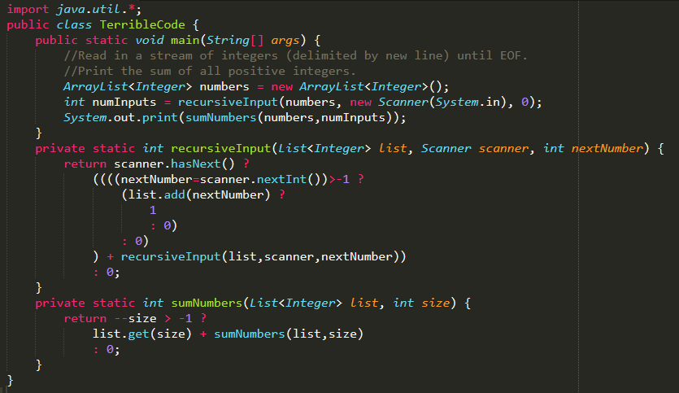
Mystery Code
Work done: Renamed inputs to methods
Better?
Notes:
Split complicated 1-liners (methods)
And rename method parameters

Slide 20
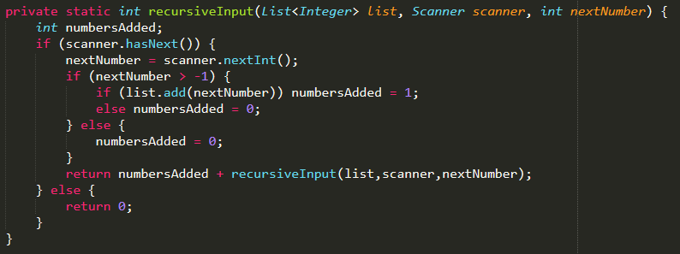
Mystery Code
Done?
No.
Work done: Change ternary operator to if-else for readability
Notes:
Change inline ifs into proper ifs

Slide 21
Mystery Code
Done?
No.
Go through logic of code – The variable is never used meaningfully
Notes:
numbersAdded is useless

Slide 22
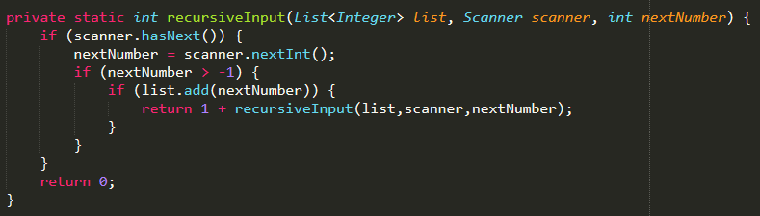
Mystery Code
Done?
Almost.
Notes:
Remove numbersAdded and useless elses

Slide 23

Mystery Code
Done?
Almost.
This is useless code according to Java docs.
Notes:
Remove numbersAdded and useless elses

Slide 24
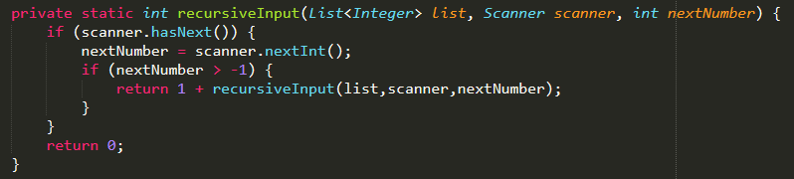
Mystery Code
Done?
Yes!
Notes:
Remove numbersAdded and useless elses

Slide 25
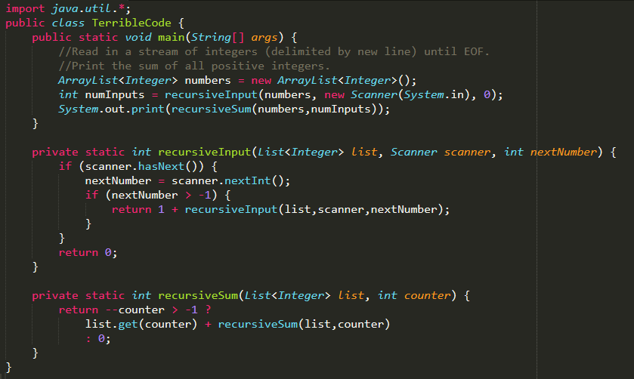
Not Mystery Code
More readable than the original right?
Left as an exercise for the reader.

Slide 26
Key learning points
Use meaningful variable and method names
NO MATH NOTATION ALLOWED (f,g,h, etc.) – Exception: i,j,k,l for loops (common practice)
Split complex code into multiple lines, use new variables if you have to
Comment code if it is not immediately obvious what the method / code does (by looking at the method name)
Generally, ternary operator should not be used for complex code, use if-else instead

Slide 27
Like what you see?
http://ioccc.org/ for more bad code or join competitive programming.

Slide 28
import java.util.*;
public class j {
public static void main(String[] args) {
//Read in a stream of integers (delimited by new line) until EOF.
//Print the sum of all positive integers.
ArrayList<Integer> l;
System.out.print(new j().f((l=new ArrayList<>()),new j().r(l, new Scanner(System.in), 0)));
}
int r(List<Integer> s, Scanner i, int k) {return i.hasNext()?((((k=i.nextInt())>-1?(s.add(k)?1:0):0))+r(s,i,k)):0;}
int f(List<Integer> l, int z) {return --z>-1?l.get(z)+f(l,z):0; }
}

Slide 29
import java.util.*;
public class j {
//Read in a stream of integers (delimited by new line) until EOF.
//Println the number of non-negative integers, a space, followed by the sum of all positive integers.
//Assume that sum of values will not exceed the size of an integer, and that there are at least 2 values.
public static void main(String[] args) { System.out.println(new j().r(0, new Scanner(System.in), 0)); }
String r(int z, Scanner i, int k) {
return z!=0?(i.hasNext()?((((k=i.nextInt())>-1?((z+=k)!=-1?1:0):"\0"))+r(z,i,~k)):" "+z):Arrays.stream((i.hasNext()?((((k=i.nextInt())>=0?((z+=k)==k?z&1:0):"\0"))+r(z,i,z^k)):" "+z).split(" ")).reduce((a,b)-> (a.length() + " " + b)).get();
}
}

Slide 30
Level 2: Abstracting into methods

Slide 31
Context for the examples
Java pseudocode for a chatbot (based on real old PHP code)

Slide 32
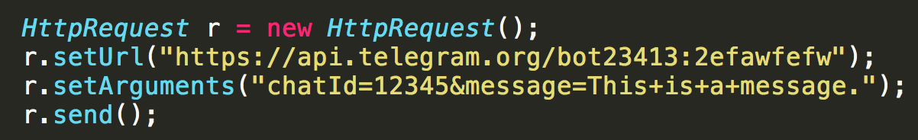
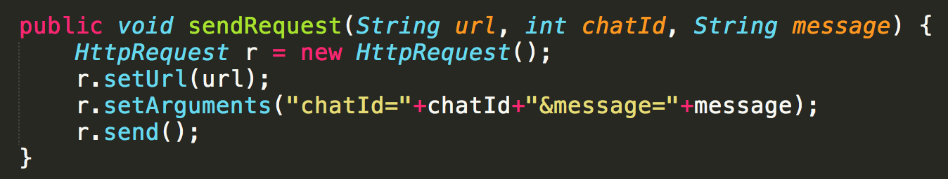
Abstracting into methods
First use case: If you need to copy-paste a block of code, put it into a method
Reduce repetition
Easier to modify
vs
Notes:
First case: Need to copy paste block of code for each message.
Second case: Duplicate 1 line of code

Slide 33
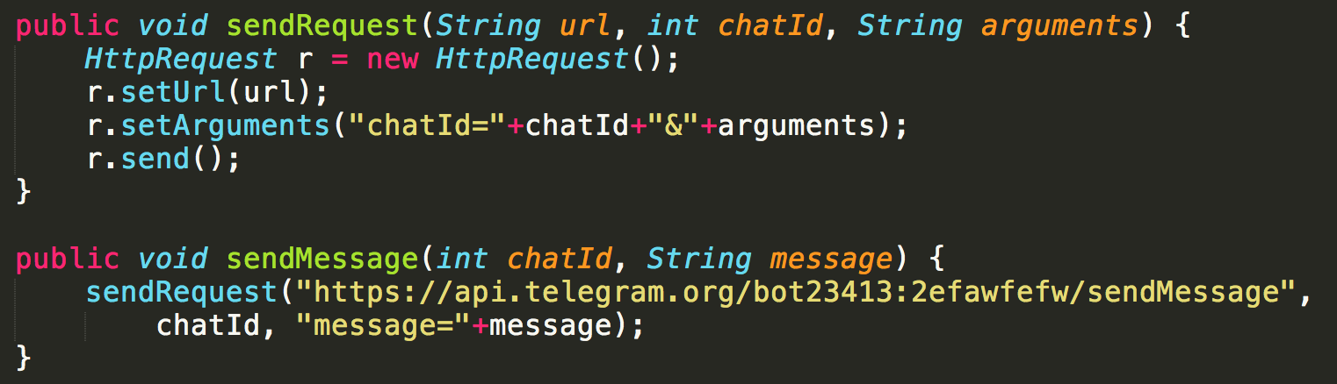
Abstracting into methods
vs
Notes:
First case: Pass the URL into every method call. What if URL changes?
Second case: Change URL in one place

Slide 34
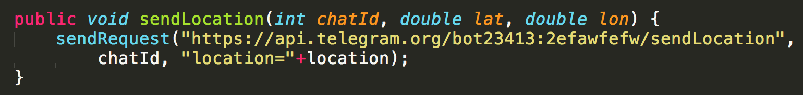
Abstracting into methods
Notes:
Now make it easier to add new functionality

Slide 35
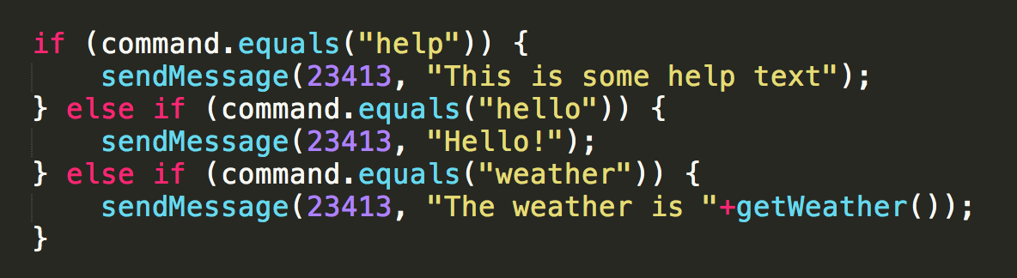
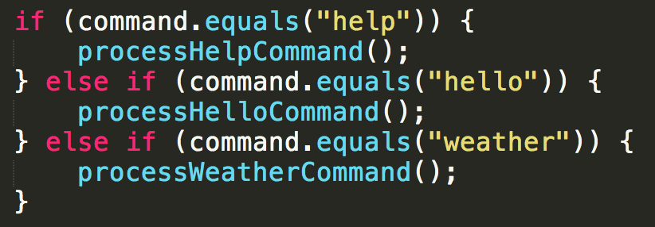
Abstracting into methods
Second use case: Make code cleaner
(this is a very simplified example)
vs

Slide 36
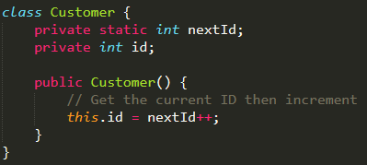
Abstracting into methods
Simpler example
What if I want to be able to reuse IDs?
Example: Restrict IDs between 1000 & 2000 and loop back

Slide 37

Abstracting into methods
Maybe like this?
Example: Restrict IDs between 1000 & 2000 and loop back

Slide 38
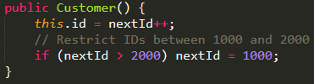
Abstracting into methods
Comments make it clearer?
Example: Restrict IDs between 1000 & 2000 and loop back

Slide 39
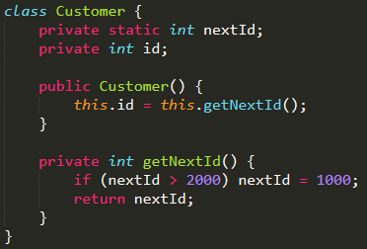
Abstracting into methods
Ask yourself: From the point of view of the constructor, does it need to care about how your IDs are implemented?
No. It just needs the next ID.
Now your ID implementation can change and not affect the rest of the code. E.g. Every even number

Slide 40
Level 3: Abstracting into classes

Slide 41
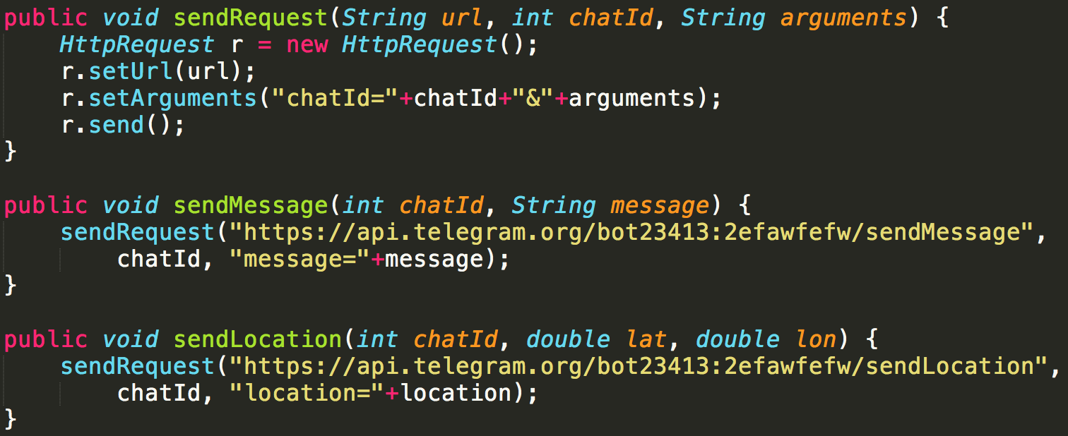
Abstracting into classes
1st Use Case: Share common data

Slide 42
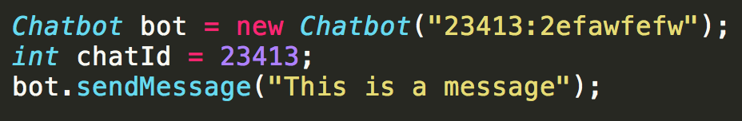
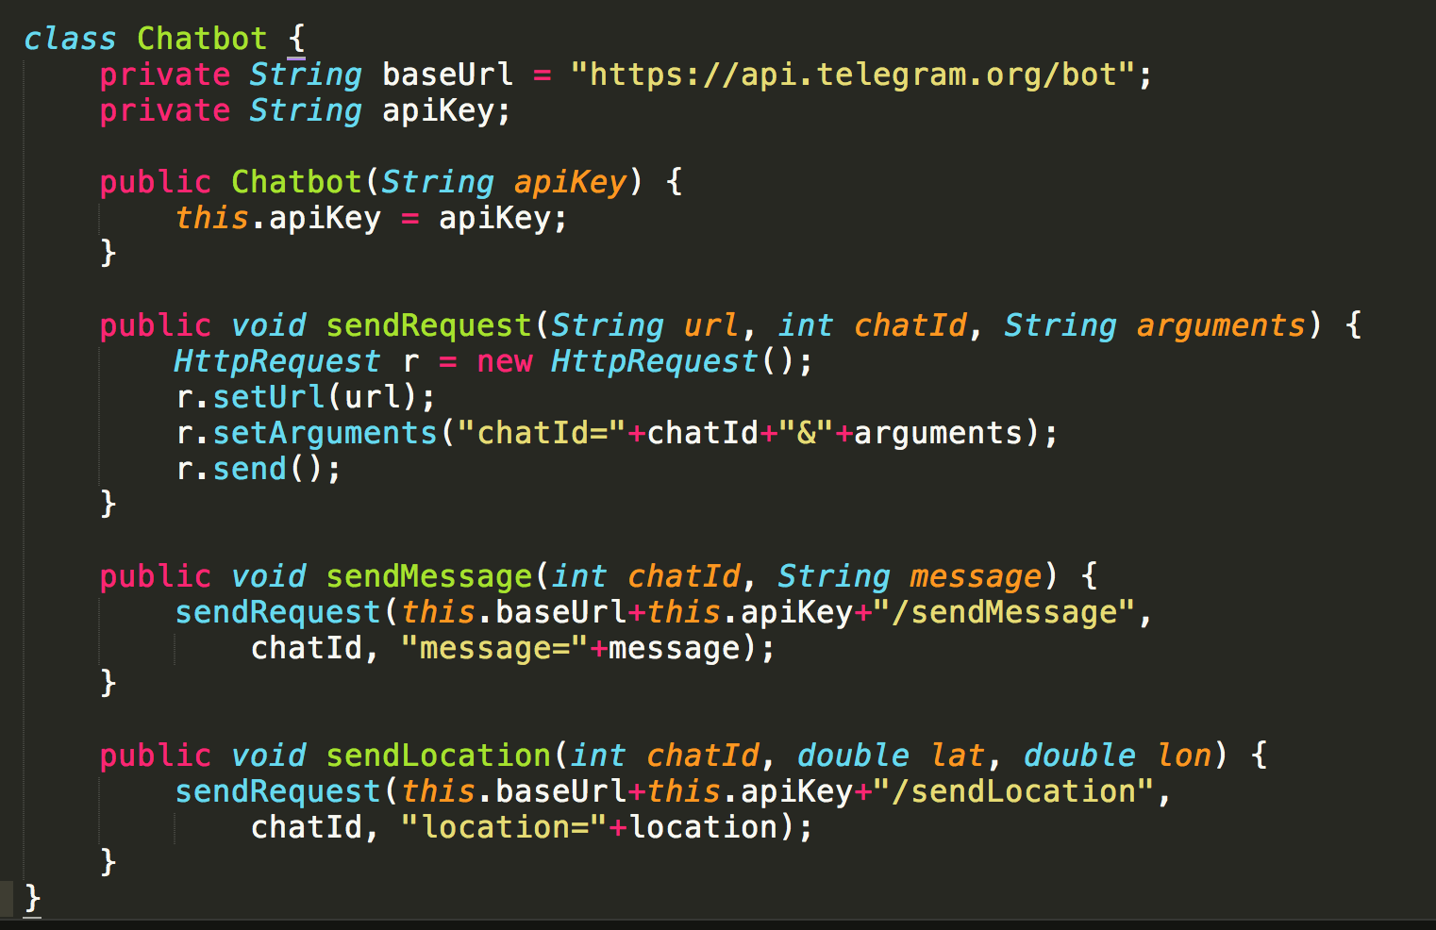
Abstracting into classes

Slide 43
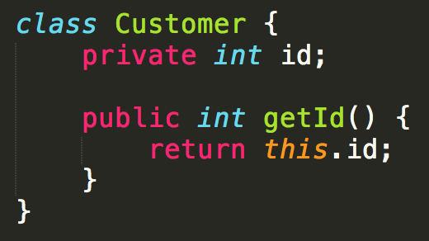
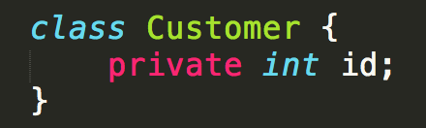


Abstracting into classes
Don’t store the same data twice, only use what you need
vs

Slide 44
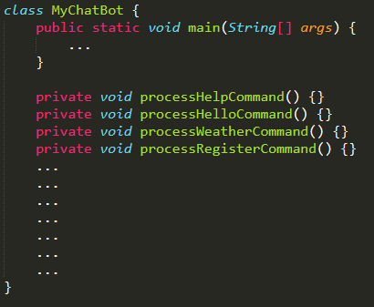
Abstracting into classes
*More advanced* It is okay if you do not understand this part.
Second use case: Too many methods
Each method has many lines of code
Very complicated and hard to navigate

Slide 45
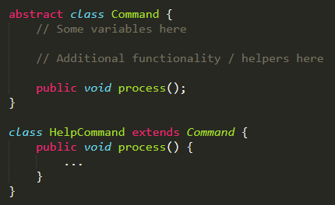
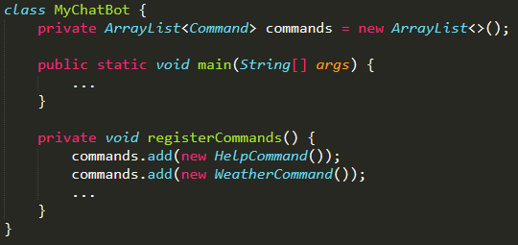
Abstracting into classes
Much more manageable.

Slide 46
If you’re interested in real code
https://github.com/keythkatz/Telegram-Bot-Core
Heavily abstracted with barely any reuse
E.g. HelpCommand extends Command Command extends ForwardableHandler ForwardableHandler extends BaseHandler

